Slide 1
project management
and specs
Andy Acs
PDM7

Slide 2
technology for pm
CONCEIVE
PLAN
DEVELOP
ITERATE
LAUNCH
STEADY STATE
MAINTAIN
OR KILL

Slide 3
learning objectives
project management and specs
Learn how to create a simple spec to communicate products to developers
Describe the Agile framework and why it is important to development processes
Understand how developers estimate task size
Learn about the different tools used to track tasks and time

Slide 4
project management and specs
specs

Slide 5
what is the
purpose of a
product spec?
specs
Notes:
Ask the class what they think the purpose of a product spec is. List out all the things they say on the white board.

Slide 6
what is the
purpose of a
product spec?
specs
Put ideas into writing to communicate intentions across teams (management, marketing, dev)
Reference for developers to see what they are building
Detail the needs and requirements to build the product
Communicate the PM’s understanding for market research, purpose of building product, KPIs, risks, and assumptions
Notes:
Ask the class what they think should be included in a product spec. List out all the things they say on the white board.

Slide 7
what should be included in a
product spec?
specs
Notes:
Ask the class what they think should be included in a product spec. List out all the things they say on the white board.

Slide 8
specs
key product spec components
elevator pitch - overview
purpose of building product
strategic / market insights
details of product
challenges / risks

Slide 9
spec
types of product documents
product
requirements
functional
spec
technical
spec
Describes business requirements, market analysis, Storyboards, User Stories, Features, Functional Requirements
A break down of everything that will go into the product and how each feature will function. Includes wireframes, product details, features, and dependencies.
Written by the development team. Details the technical requirements to build the product including data structures, technologies considered or used.

Slide 10
*Examples of Functional Spec and Product Requirements Spec*
spec

Slide 11
keep it simple.
spec
Notes:
Explain that if you write specs that are too long and detailed, developers will not read everything. Keep it very clear and know your team. If you’re working with an off shore team, you’ll have to make it more detailed. If you’re working closely together, use the doc to facilitate collaboration rather than write everything in your head.

Slide 12
Spec
the right product spec document is the one that works for your company.

Slide 13
project management and specs
agile

Slide 14
what is agile development?
agile
A flexible process that takes an iterative approach to development that adapts to uncertainty.

Slide 15
agile manifesto
agile
Individuals and interactions over processes and tools.
Working software over comprehensive documentation.
Customer collaboration over contract negotiation.
Responding to change over following a plan.

Slide 16
scrum
agile
One practice of Agile methodology that focuses on small, incremental releases built during sprints.
Benefits of Scrum:
Deliver products faster
Can adapt to changing business priorities and requirements
Better resource management
Sustainable pace

Slide 17
involved vs committed
agile
A Pig and a Chicken are walking down the road. The Chicken says: "Hey Pig, I was thinking we should open a restaurant!" Pig replies: "Hm, maybe, what would we call it?" The Chicken responds: "How about 'ham-n-eggs'?" The Pig thinks for a moment and says: "No thanks. I'd be committed, but you'd only be involved!"

Slide 18
scrum players
agile
Actors: Product Owner, Scrum Master, Pigs (your team), Chickens (others)
Product owner is in charge of the Product Backlog, where all the ideas go and are prioritized. This is either you or your boss.
Scrum Master is probably you - Project Manager who runs day-to-day, keeps the team running as efficiently as possible.

Slide 19
scrum rituals
agile
Sprint: time period for executing a set of tasks / user stories before stopping for reflection and re-assessment. Typically 1, 2, 4, or 6 weeks.
Inception Meeting: overall project kickoff meeting
Iteration Planning Meeting: sprint kickoff meeting
Daily standup: status meeting Scrum Master (you) run with team every day
Retrospective: end-of-sprint meeting to look back and reflect on how things went and what could be improved
Velocity: the amount of work the team can accomplish in a sprint

Slide 20
How does a scrum work?
agile
Start with the idea at the top of the product backlog.
Work with your leads (tech / design) to break down the idea into features on the sprint backlog.
At the inception meeting, present the idea to the team, giving them an overall sense of the vision, plan, timelines, etc. Then start the first IPM (iteration planning meeting).
At the IPM, work with the team to further break down features into user stories and estimate complexity. Most people estimate with “points”.
Prioritize the user stories based on a combination of uncertainty, value, and dependencies (can’t do B until we have A).

Slide 21
How does a scrum work?
agile
# of stories to be done in the sprint is determined by the team’s past velocity.
The Scrum Master (you) runs daily standups. What did you do yesterday, what will you do today, are you blocked / how can the team help?
People who are involved can watch, but only committed people can talk.
The Scrum Master protects the team from distractions. Ideally, only work agreed to in the IPM is done during the sprint. New work can wait for the next IPM. In reality, can be hard to do because stuff comes up.

Slide 22
agile
owner status points
As a user, I can reset my password when I forget it.
Tim In Progress 5
As a user, I can create a new account.
Jan Done 3
Notes:
Explain that you would track everything on the boards to see what is in progress, done, or not started yet with the number of story points.

Slide 23
statuses for stories
agile
Unassigned: a story gets assigned when it starts to get worked on
In progress: someone is actively looking at or working on the story
Blocked: the story is on hold due to requirements that have not been met
Done: finished story, ready for testing

Slide 24
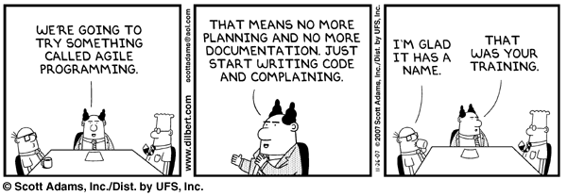
most people misunderstand agile…
agile

Slide 25
project management and specs
tools

Slide 26
how do we manage stories and work on a daily basis?
tools

Slide 27
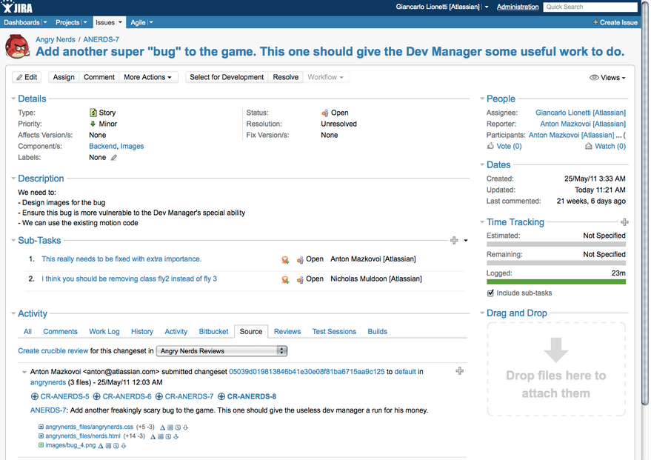
jira
tools
Notes:
Jira is a project management tool that allows you to spec out features in epics (large feature sets) for agile, and add individual tasks under them. These are called tickets and each are assigned a number. They track the status and who is assigned what. There are tools you can implement to make scrum most effective. Very robust system, very customizable, but also expensive.

Slide 28
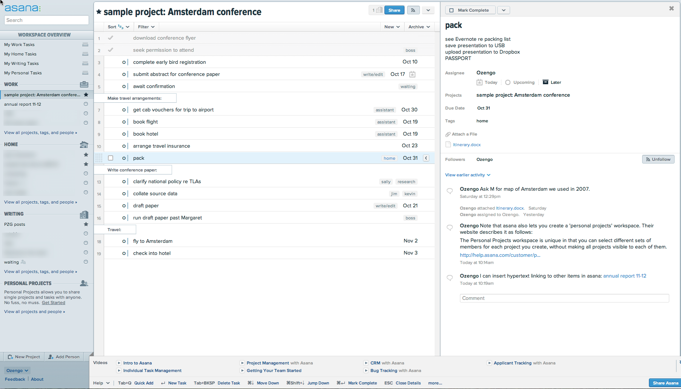
asana
tools
Notes:
Asana is similar to JIRA but less robust. You can enter tickets more quickly, but it’s not as customizable as JIRA. Free to start using.

Slide 29
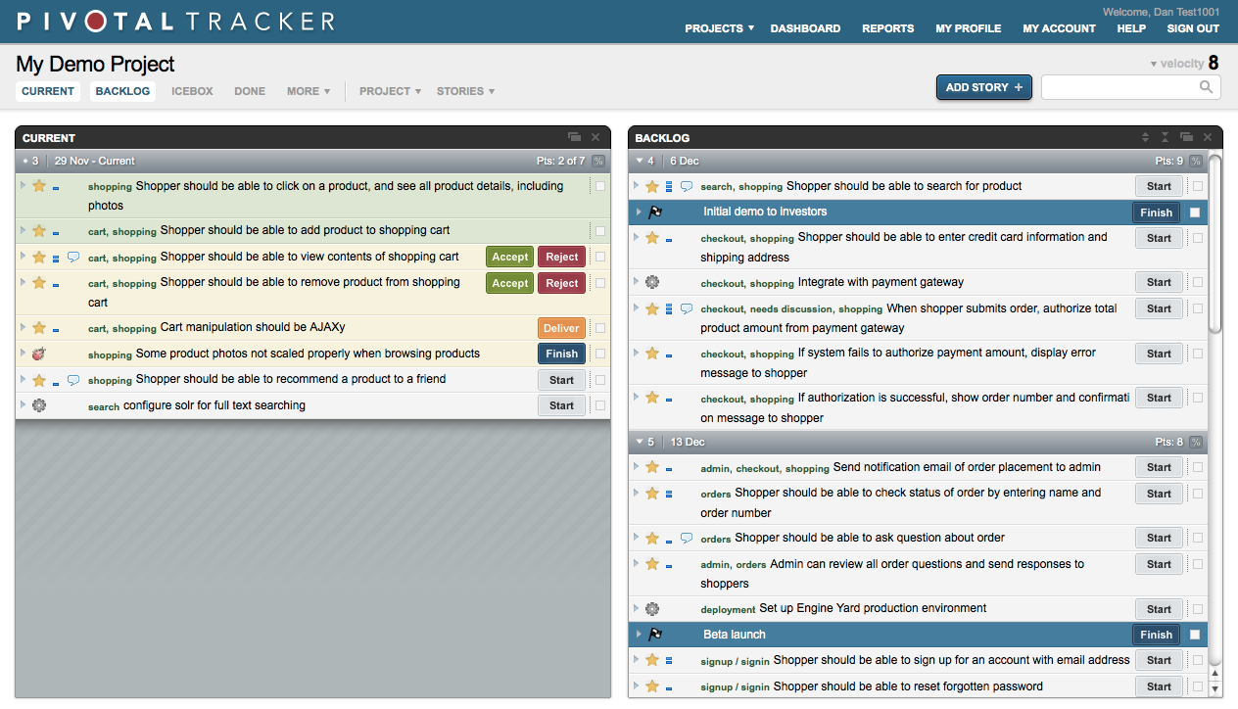
pivotal
tracker
Tools
Notes:
Pivotal Tracker focuses on stories. They have you write in you user stories and get more detailed in the notes. Not great for tracking bugs.

Slide 30
Project management and specs

